Slide 1
SORT OPTIMATION
2021/6/4 BEIJING.
Vulcan

Slide 2
CONTENTS
01.
SORT MEANING
02.
BUBBLE\SELECTION\INSERTION
03.
BREAKTHROUGH
04.
CONCLUTION
Notes:
This is personal research and sharing, and it does not represent authority. For discussion and thinking only. It is precisely because these traditional algorithms are only the simplest version every time. It is helpful to discuss their essence and optimization techniques.

Slide 3
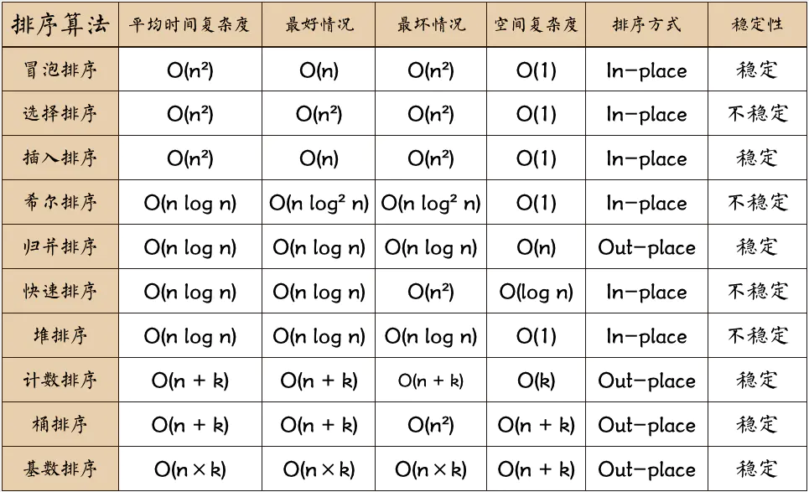
SORT MEANING(MOTION)
Problem: It reorders the items in an array(or list) in a certain order(descending or ascending).
1.Understand the essence of sorting and ideas for solving and optimizing problems.
2.O(N^2)、O(NlonN)、O(N)
3.Stable/Unstable
Notes:
As a classic topic of computer, sort algorithm is often used to show data structure and algorithmic thinking. Divide and conquer, recursion, random algorithms, O(), compare or not compare strategy can be seen everywhere. In order to facilitate the discussion, the following default ascending sorting.

Slide 4
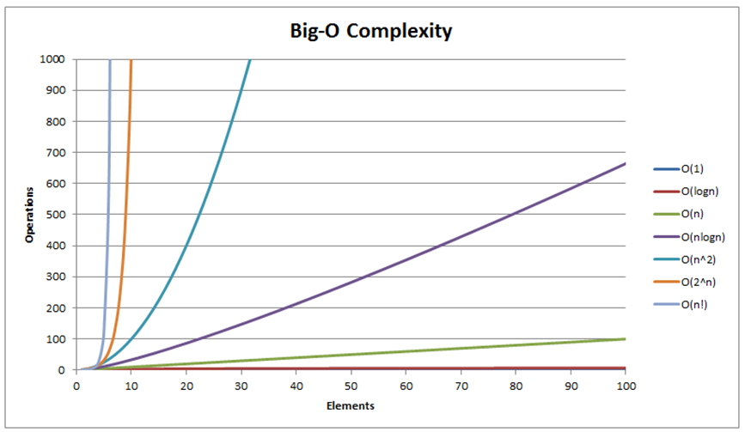
BIG O

Slide 5
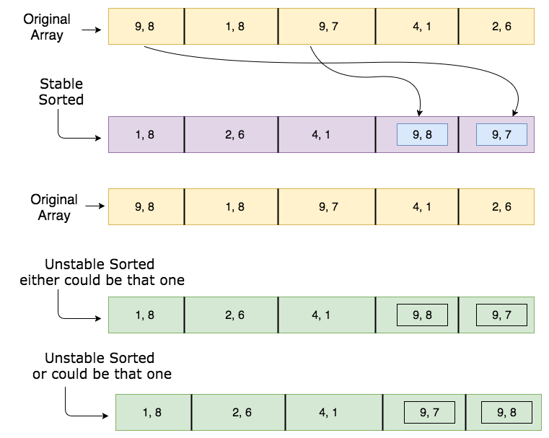
sort stablity
Notes:
Sorting algorithm is stable if whenever there are two records R and S with the same key and with R appearing before S in the original list, R will appear befor S in the sorted list.
https://www.javatpoint.com/daa-stable-sorting
https://stackoverflow.com/questions/1517793/what-is-stability-in-sorting-algorithms-and-why-is-it-important

Slide 6
Melleability Problem
LOOKING FOR A SPECIFIC VALUE
FIND THE MAXIMUM/MINIMUM VALUE
TEST ELEMENT UNIQUENESS
CUDA PARALLEL
SEARCH ENGINE
Notes:
延展性问题

Slide 7
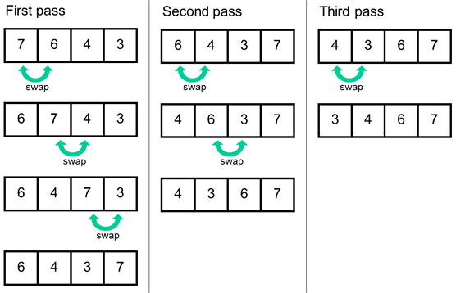
BUBBLE SORT(STABLE)
By comparing adjacent elements in pairs, push the largest element to the end.
.First pass:ARR=[a,b,c,d]
if a > b:
ARR[b_idx],ARR[a_idx] = a, b
next, compare (a,c)
Until the last element is compared.
.iteration or recursion

Slide 8
BUBBLE SORT-BIG O
c++:
void bubble_sort_v1(int *arr, int N)
{
for (int i = 0; i < N-1; i++)
for(int j = 0; j < N-1-i; j++)
{
if (arr[j] > arr[j+1])
swap(arr, j, j+1)
}
}
BIG-O:
Comparison and exchange usually take a constant time, called c.
1. i = 0, (N-1) times iterator
2. i = 1, (N-2) times
3. i = 2, (N-3) times
4. i = N-1, 0 times
total times = (N-1) + (N-2) + (N-3) + ... + 1 + 0
= N*(N-1)/2
T = c*N*(N-1)/2 = O(N^2)

Slide 9
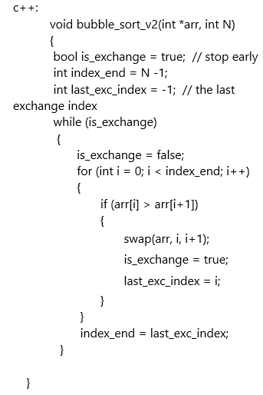


OP-BUBBLE SORT
Notes:
In such an orderly situation, a complete comparison process still needs to be arried out to think about whether it can be stopped early. Performance can be imProved, but the time complexity has not changed. When the amount of data is very large, this algorithm may cause a crash. how many real swaps/comparisons are required by bubble sort?

Slide 10
BUBBLE SORT-C
12 | 2 | 23 | 12 | 20 | 29
 | VERSION ONE | VERSION SEC.
SWAPS | 3 | 3
COMPARISONS | 15 | 9
Notes:
stability

Slide 11
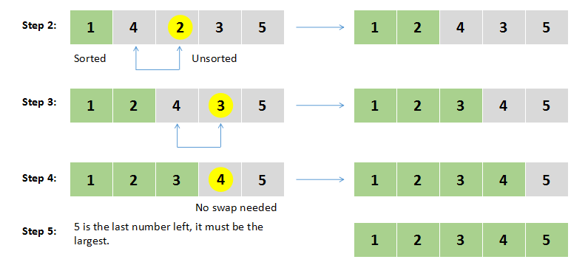
SELECTION SORT(UNSTABLE)
Find the smallest value every time and put it in the first place until it is order.
Given N items and L = 0, step:
1. find minValue X in [L...,N-1]
2. swap X and item in L
3. L++, for loop unitl L == N-2
Notes:
https://www.faceprep.in/algorithms/selection-sort/

Slide 12
SELECTION SORT
void select_sort_v1(int *arr, int N)
{
int minIndex = 0;
for (int i = 0; i < N-1; i++)
{
minIndex = i;
for (int j = i+1; j < N; j++)
{
if (arr[j] < arr[minIndex]) minIndex = j;
}
swap(arr, i, minIndex);
}
}
void select_sort_v1(int *arr, int N, int i) // i = 0
{
if (i == N-1) return; // End of recursion
int minIndex = i;
for (int j = i+1; j < N; j++)
{// Solve sub-problems
if (arr[j] < arr[minIndex]) minIndex = j;
}
swap(arr, i, minIndex);
i += 1;
select_sort_2(arr, N, i); // Recursive call
}

Slide 13
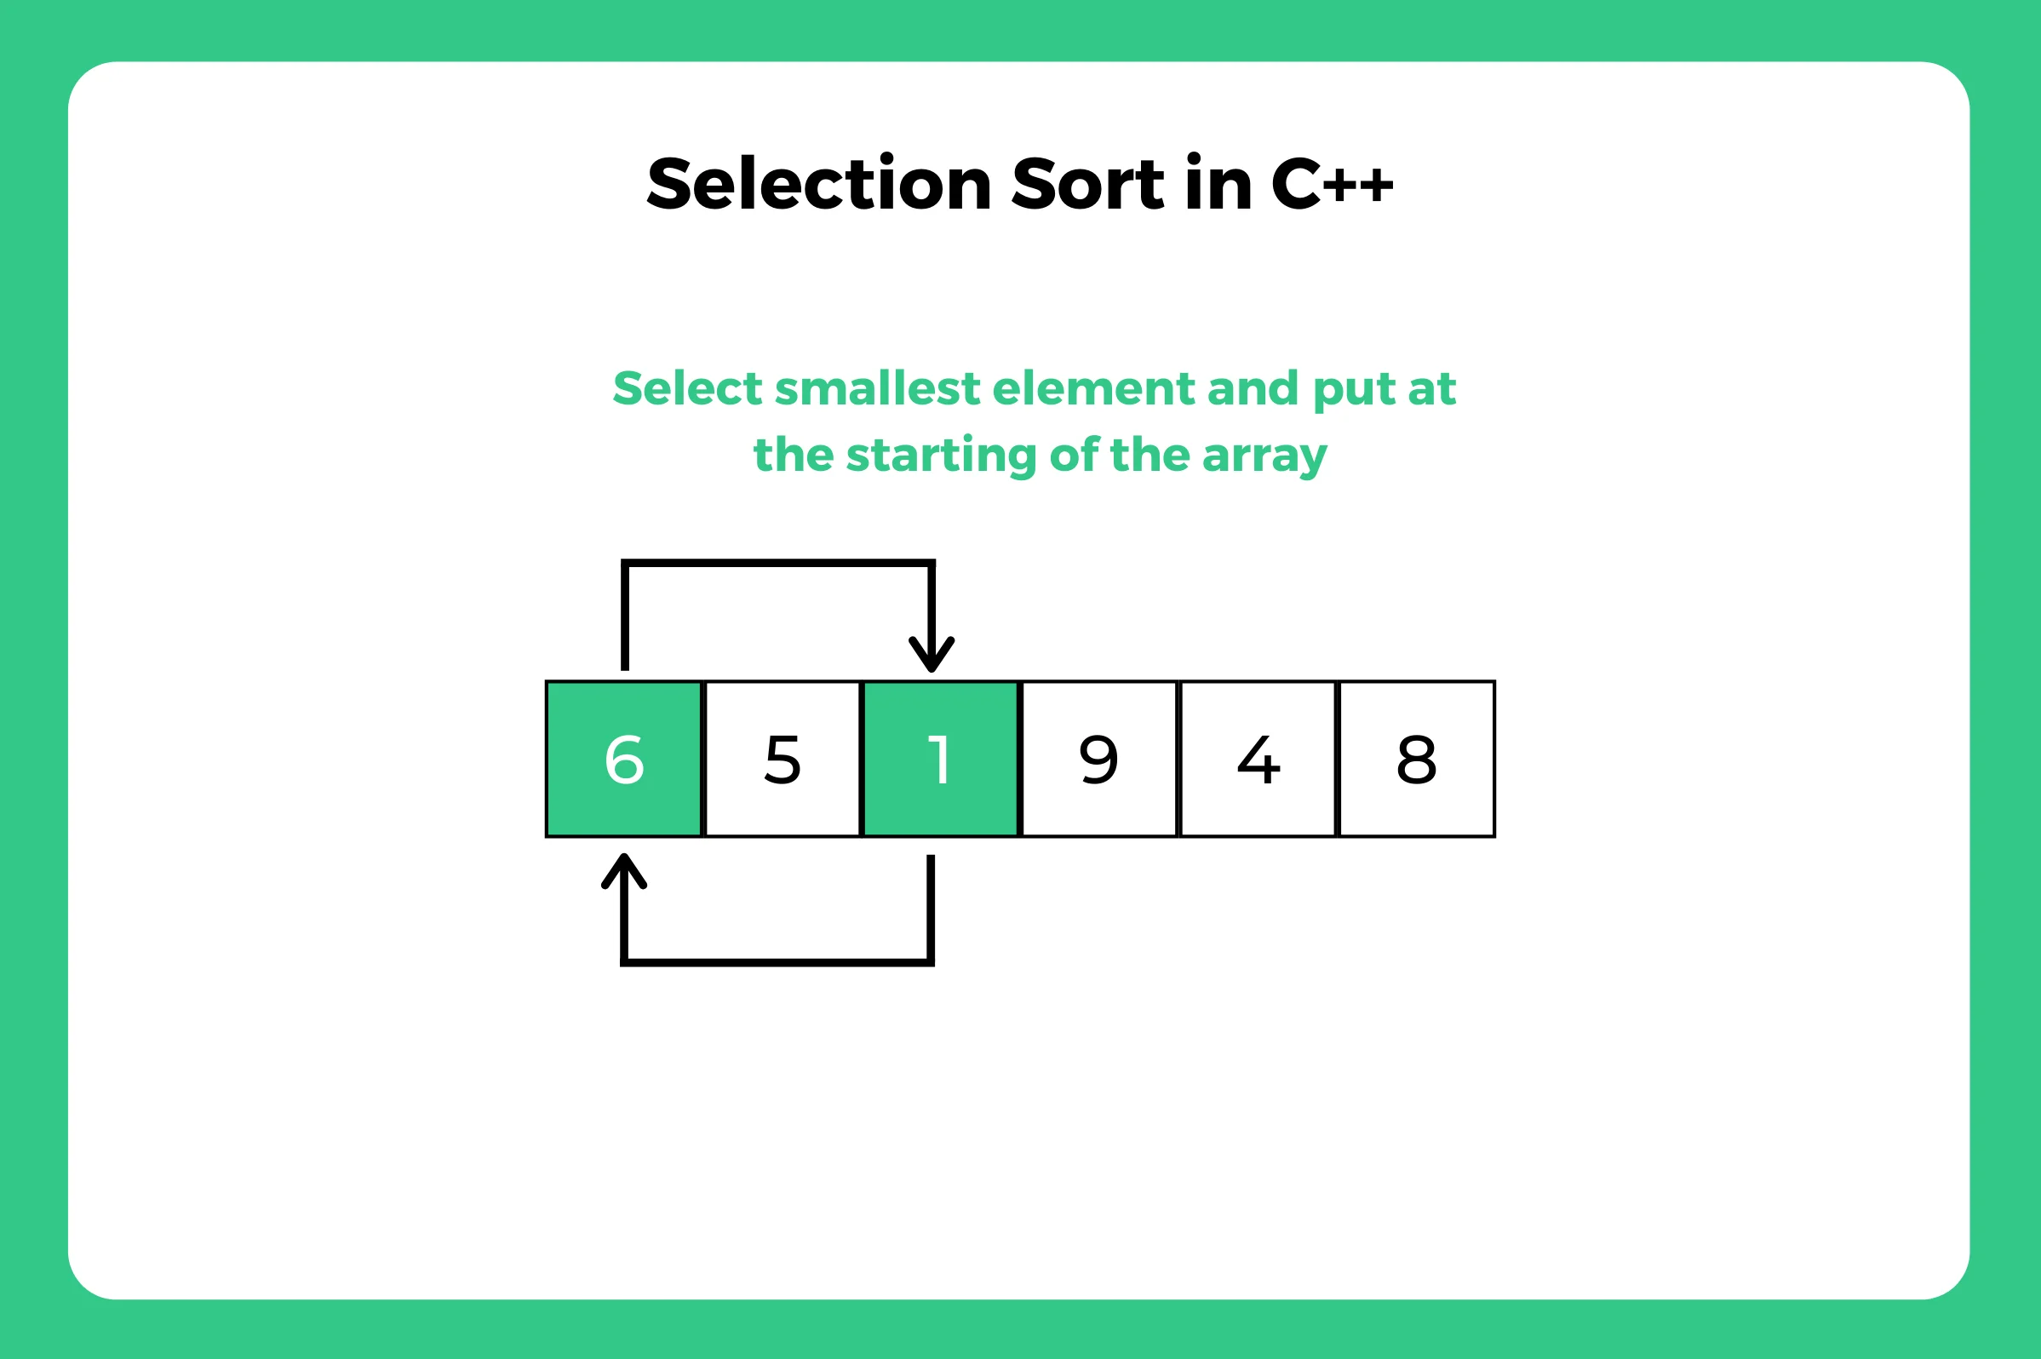
OP-SELECTION SORT
Why not put the biggest one at the end, then why not put the smallest one at the top and the biggest one at the end once.
Given N items and L = 0, M = N-1:
1. find the minValue X and maxValue R in [L,M]
2. swap X and item in L; swap R and item in M
3. L++, M-- for loop until L==N/2-1
Notes:
c++ : 2/3 == 0

Slide 14
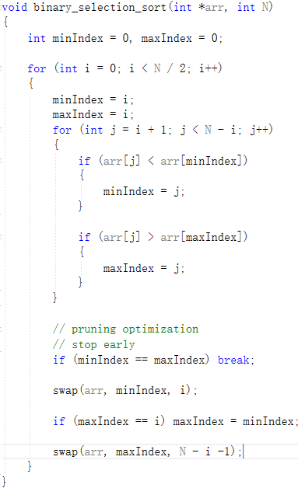

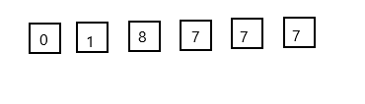
OP-BINARY-SELECTION SORT

Slide 15
SELECTION SORT-C
1. STOP EARLY
2. DIVIDE AND CONQUER
3. REDUCE THE NUMBER OF EXCHANGES

Slide 16
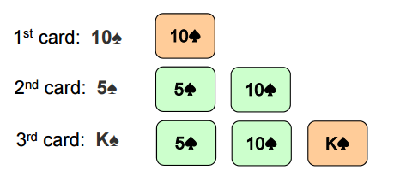
INSERTION SORT

Slide 17
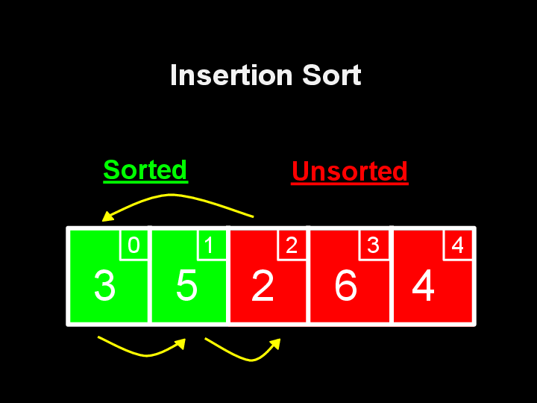
INSERTION SORT(STABLE)
void insert_sort_1(int *arr, int N)
{
for (int i = 1; i < N; i++)
{
int cur = i;
while (cur > 0 && arr[cur] < arr[cur-1])
{
swap(arr, cur, cur-1);
cur--;
}
}
}

Slide 18
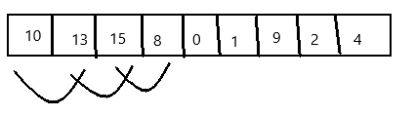
OP-INSERTION SORT
1. REDUCE THE NUMBERS OF EXCHANGES
2. Unsupervised

Slide 19
OP-INSERTION SORT
void insert_sort_v2(int *arr, int N)
{
int ind = 0;
for (int i = 1; i < N; i++)
{
if (arr[i] < arr[ind])
{
ind = i;
}
}
// put min value to first idx
while (ind > 0)
{
swap(arr, ind, ind-1);
ind--;
}
...
}
int currentNum = 0;
for (int i = 2; i < N; i++)
{
currentNum = arr[i];
int pre = i -1;
while (currentNum < arr[pre])
{
arr[pre+1] = arr[pre];
pre--;
}
// swap;
arr[pre+1] = currentNum;
}

Slide 20
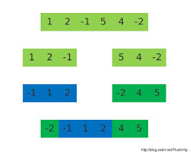
BREAKTHROUGH
The essence of sorting algorithm is actually to eliminate reversed pairs. If there are positive integers i, j such that 1 <= i < j <= n and A[i] > A[j], then the ordered pair<A[i], A[j]> is called a reversed pair of A.

Slide 21
CONCLUTION
1. The meaning of sorting algorithm
2. The way the sorting algorithm is optimized (O(n^2))
stop early
reduce the number of exchanges
dichotomy
3. The essence of sorting algorithm.

Slide 22
Thanks
Next: O(nLogN) sort optimation so on

